Slide 1
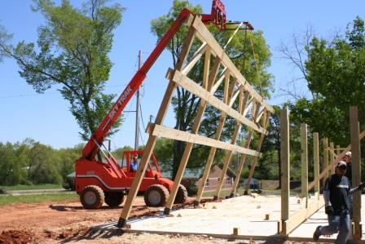
Building a Successful Farmers’ Market from the Ground Up –
10 Requirements for Success
Debra Bolding
Co-Manager, Howard County FM
Miller County Master Gardener
Arkansas Flower and Garden Show
February 26, 2017

Slide 2

Requirement #1 (2 and 3)!

Slide 3
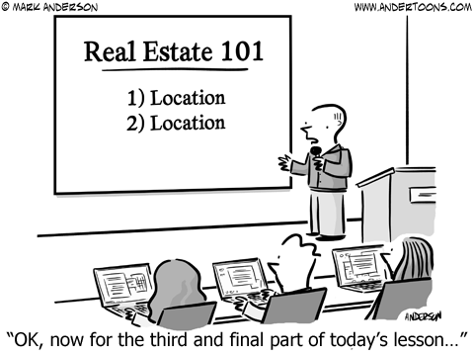
Notes:
Source: https://cdn.andertoons.com/img/toons/cartoon7454.png

Slide 4
Site Selection
Drive-by traffic
Visibility
Customer accessibility
Customer parking
Farmer and truck accessibility
Interfere with existing facilities/traffic flow?
Handicapped accessibility

Slide 5
Site Selection
Centralized location and other activity
Restrooms
Utilities – water, electricity, garbage/recycling
Shade or shelters
Ownership/Cost
Public transportation

Slide 6
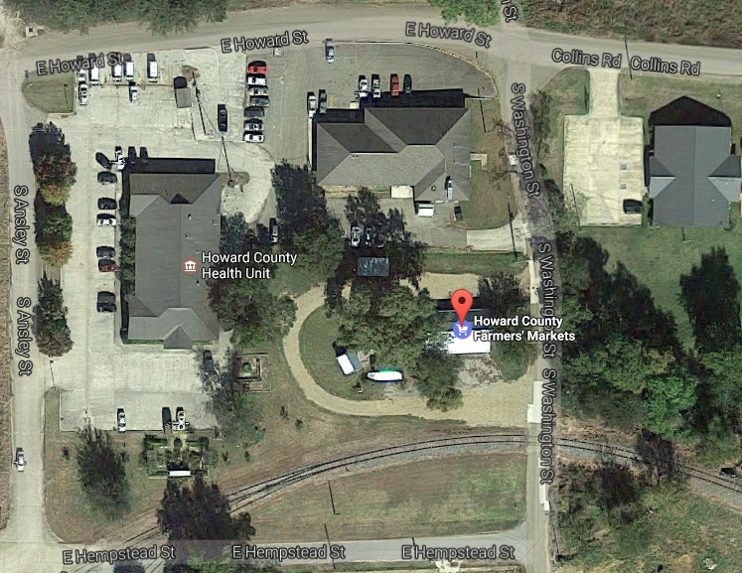

Slide 7
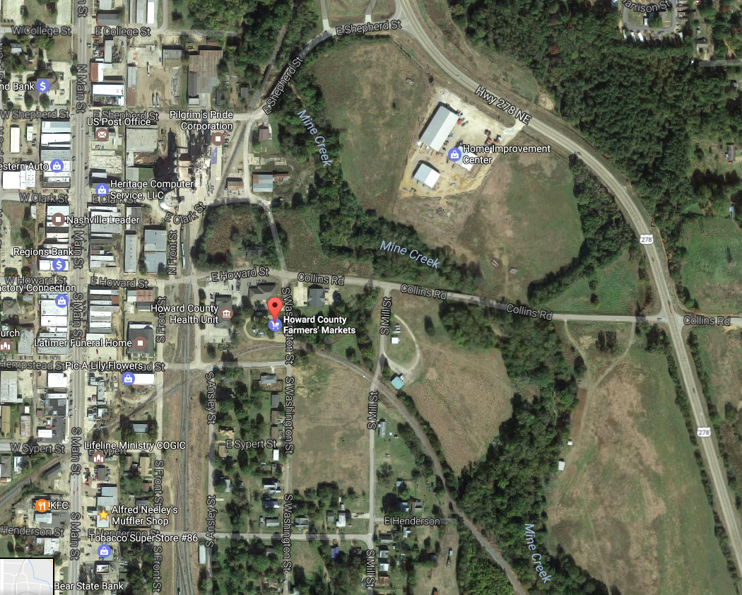

Slide 8
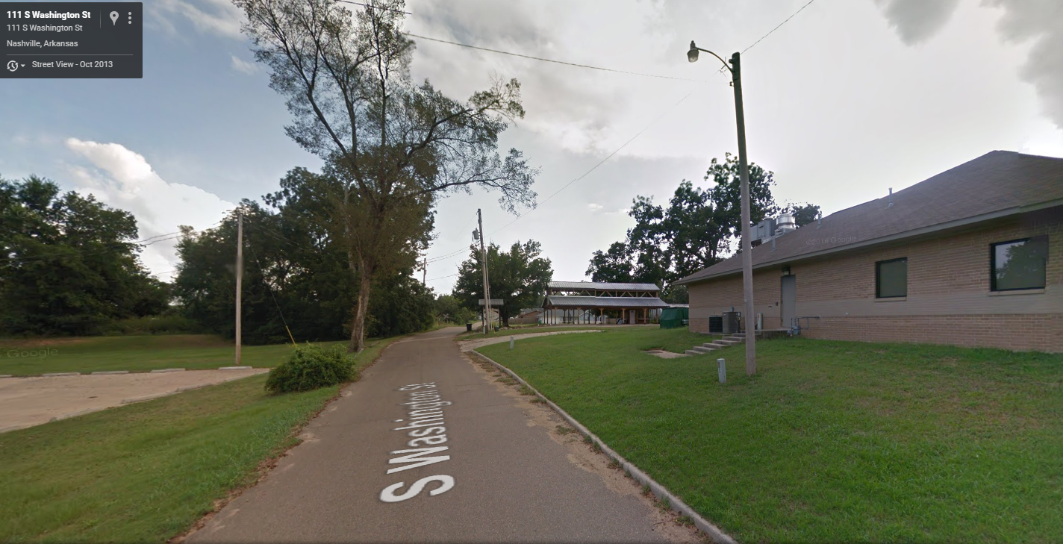

Slide 9
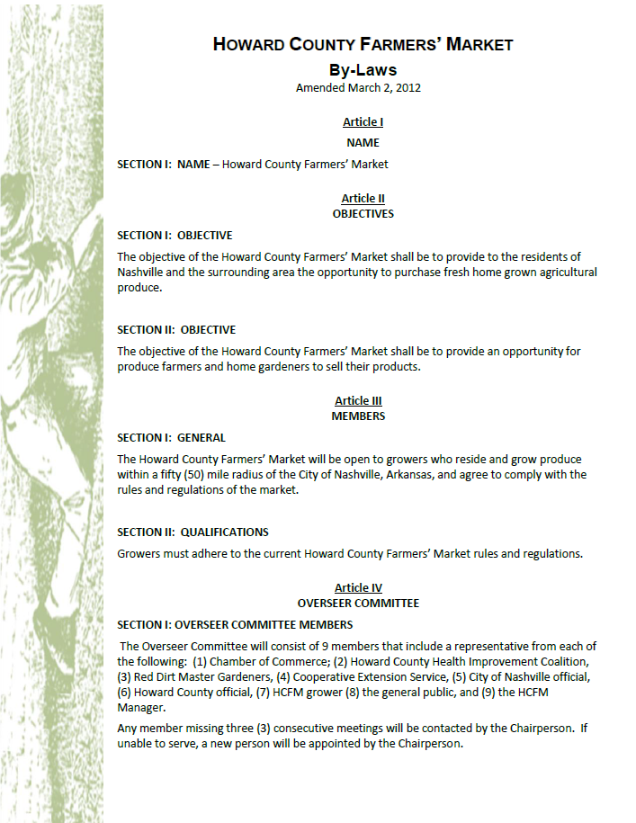
Broad Public Participation
Requirement #2
Notes:
Overseers Committee/Board of Directors
Oversee all market operations
Set broad operational parameters
Establish rules
Market Manager - community contacts, especially with the press; outreach and organizational skills; sensitive to the needs of the growers and to the community the farmers' market serves; Duties may include such items as:
Redeem food stamps
Obtain permits and insurance
Recruit farmers
Go to necessary public meetings and hearings
Promote the market
Attract feature stories in the local press
Collect fees
Carry out the directives of the Board of Directors
Additionally, if cars need to be cleared out of the parking lot, the Market Master calls the tow truck. If there are disputes on market day, the Market Master settles the conflict. If there are complaints about too little variety of produce, high prices, or price fixing, the Market Master is responsible for answering them. Once you have written the appropriate job description for your farmers' market, look for someone who can fulfill it.
Market Masters can make a big difference in assuring the success of a farmers' market. They cannot replace the role of the Board of Directors, though. The two must work together to provide cohesive leadership to the market as a whole.

Slide 10
Collaborations and Partnerships between the Local Community, Businesses and Organizations
Local Municipalities
Chambers of Commerce
Community Groups
Health Agencies
News Media
Non-Profit Organizations
Local Foundations
Youth Groups
Senior Groups
Schools
Local Cooperative Extensions

Slide 11
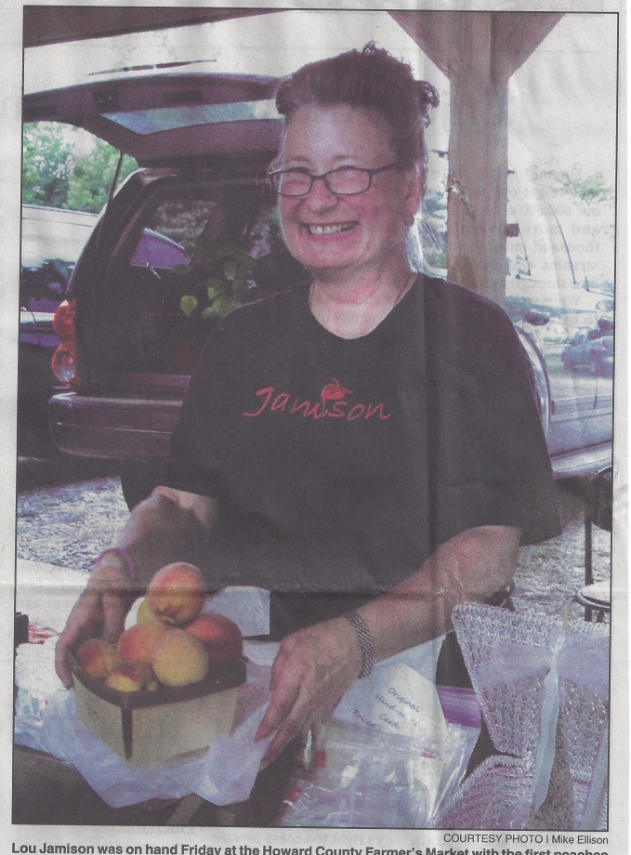
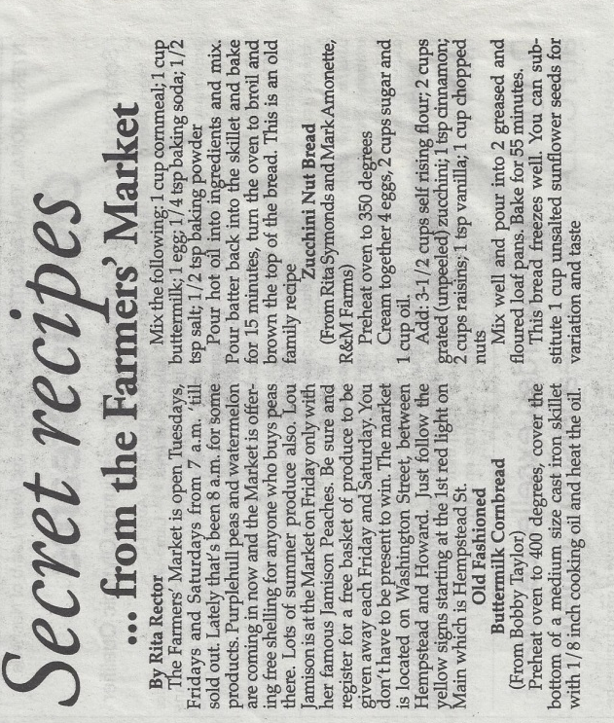
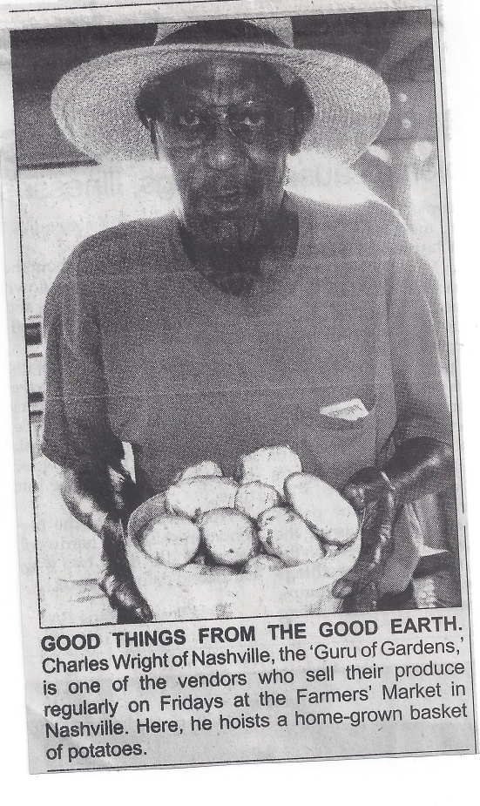

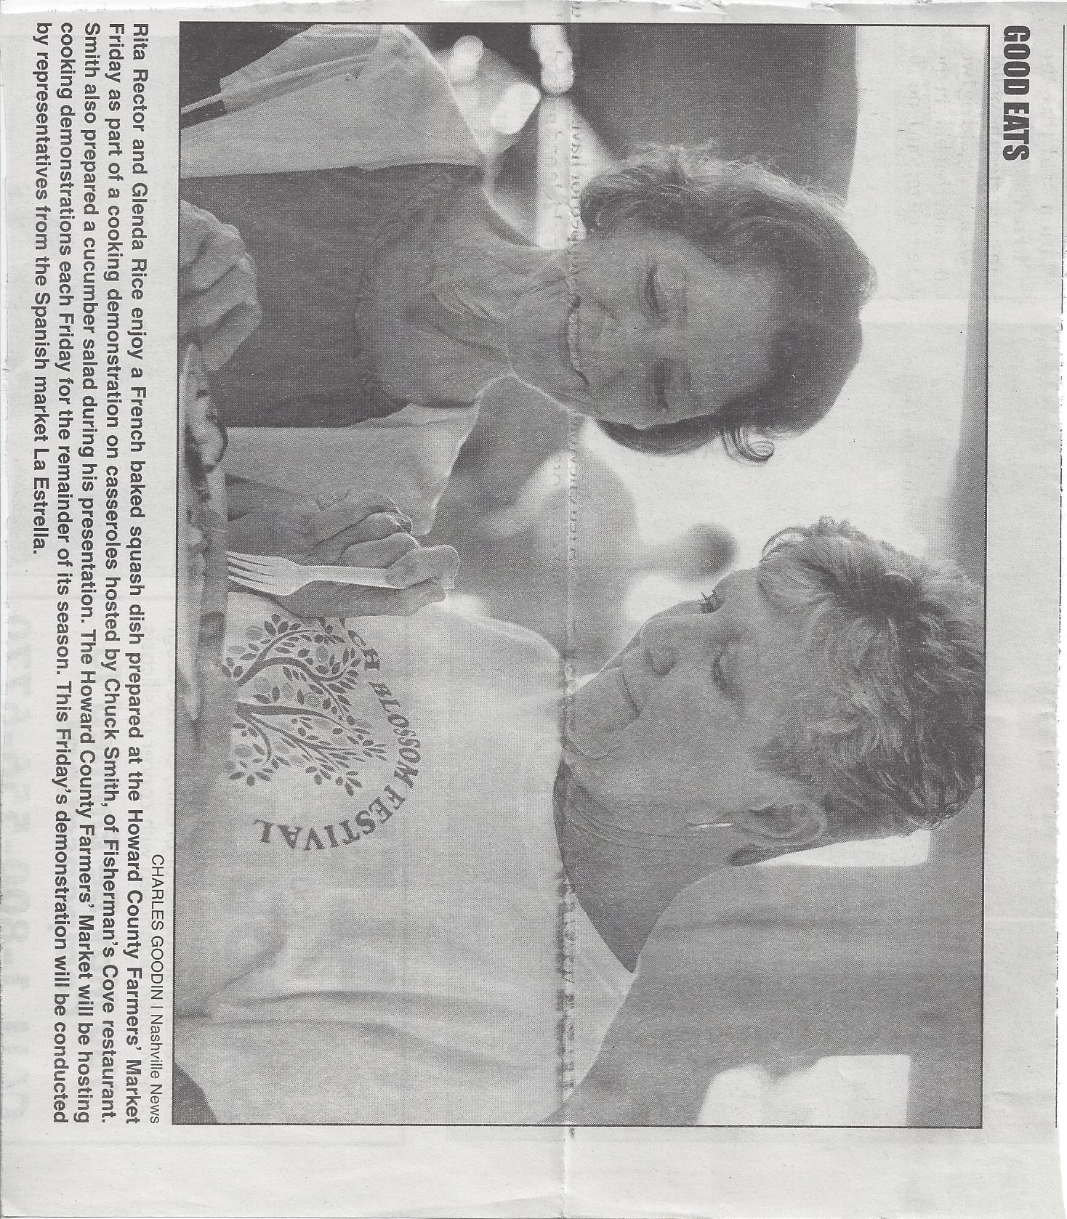
Newspaper Articles
Notes:
Cannot have too many articles:
Promote growers
Promote activities
Promote initiatives
Have SOMETHING every week if possible!

Slide 12
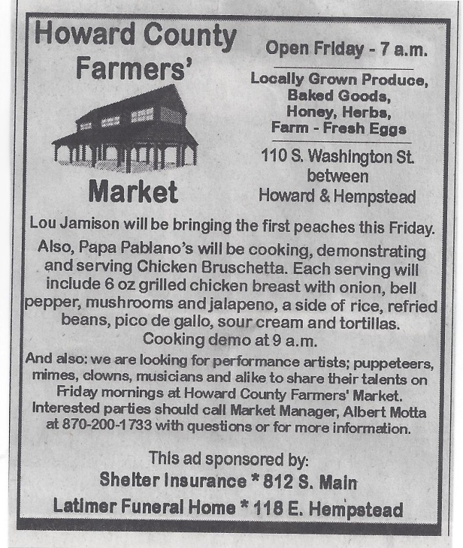



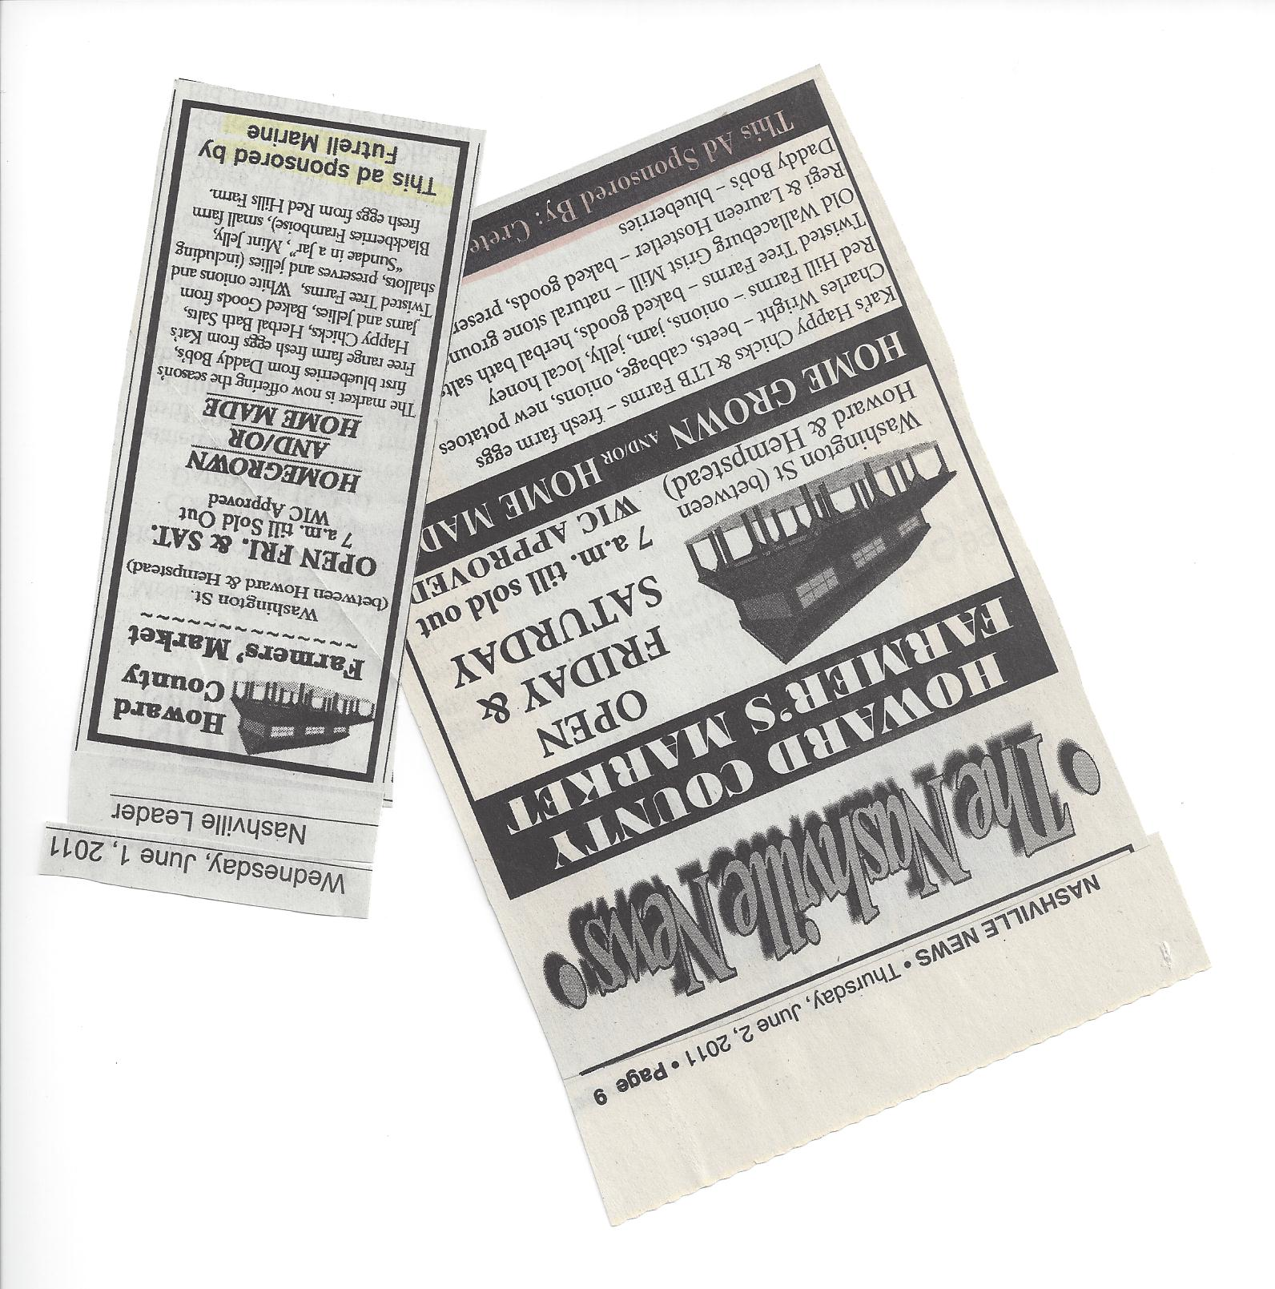
Business Sponsors
Newspaper Ads
Notes:
Not only promote market, but promote business
Show community support and collaboration
Help newspapers with needed revenue

Slide 13
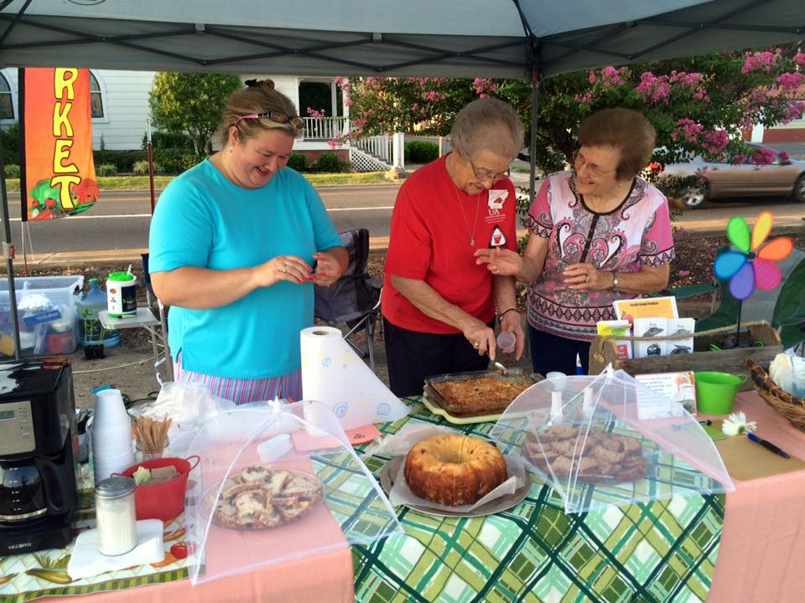
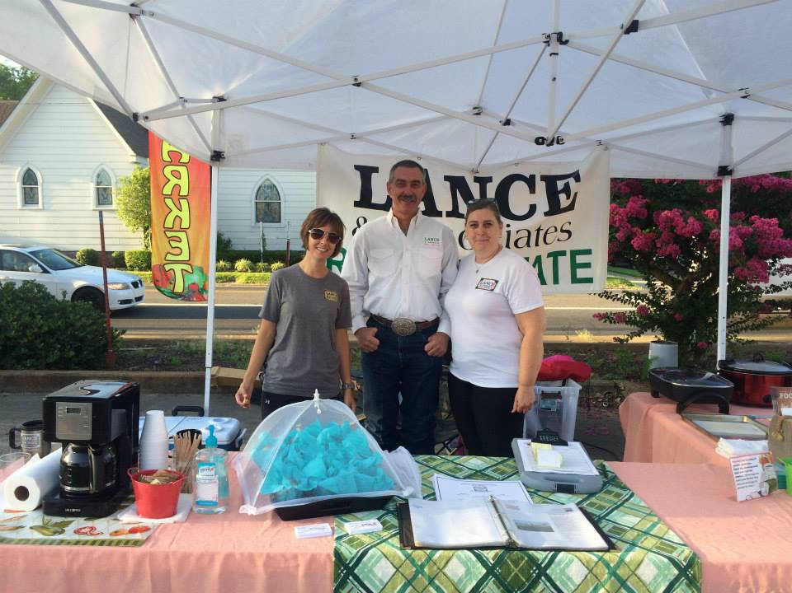
Hospitality Sponsors
Civic Groups
Businesses
Agencies
Notes:
Collaboration . . . Community Support and Involvement. . . Refreshments!!!! . . .

Slide 14
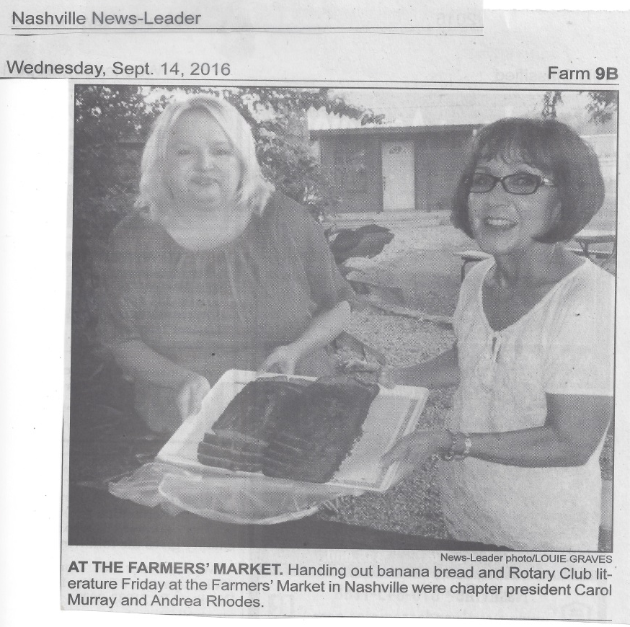
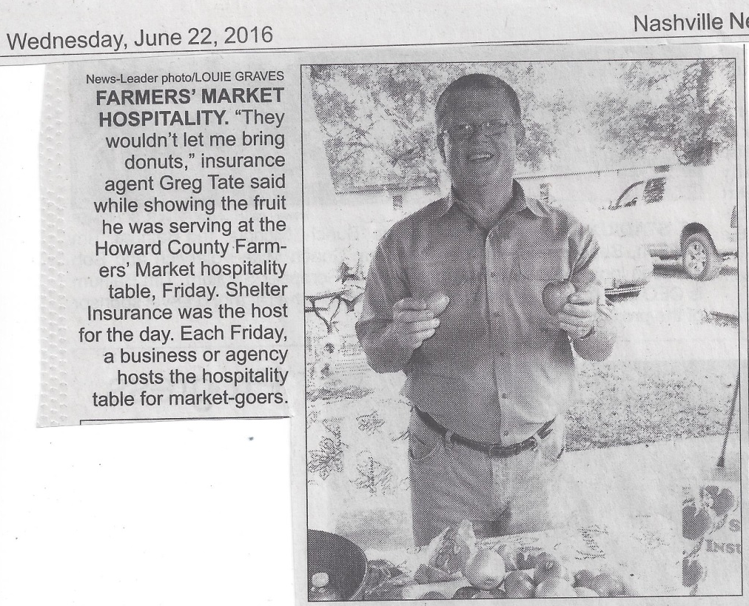
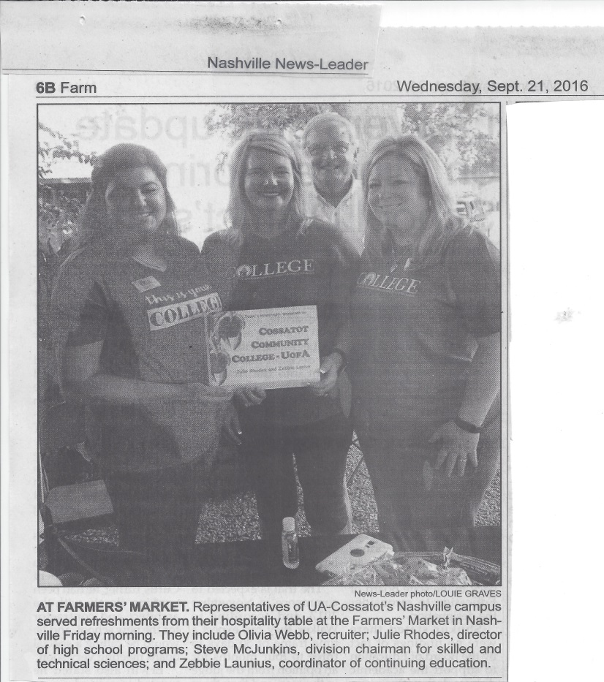
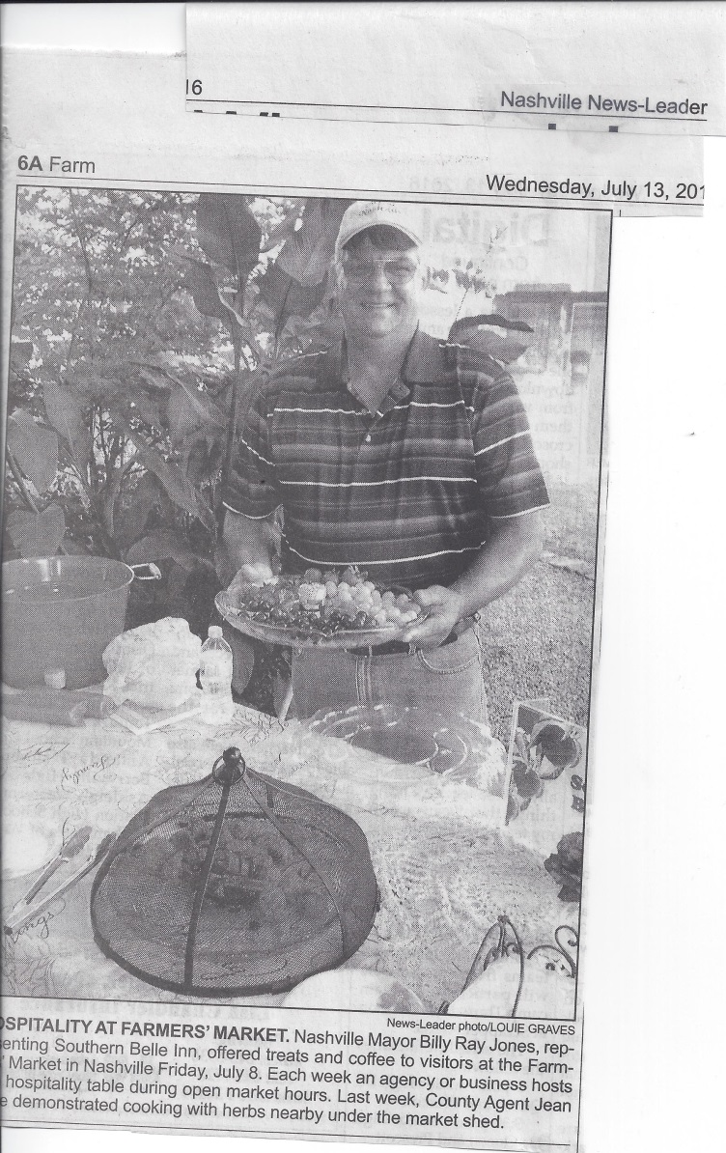
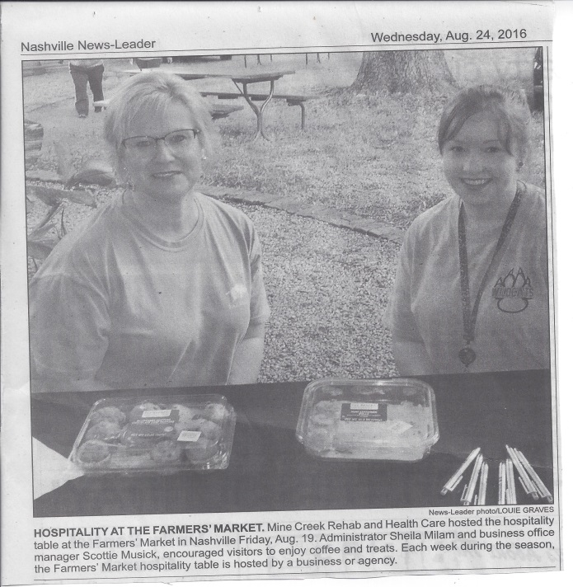
Hospitality Sponsors
Notes:
Collaboration:
Organizations/Businesses/Civic Groups opportunity to promote their services/products
Newspapers get needed community-related articles
Market gets refreshments during market and additional promotion in media
Community enhancement

Slide 15

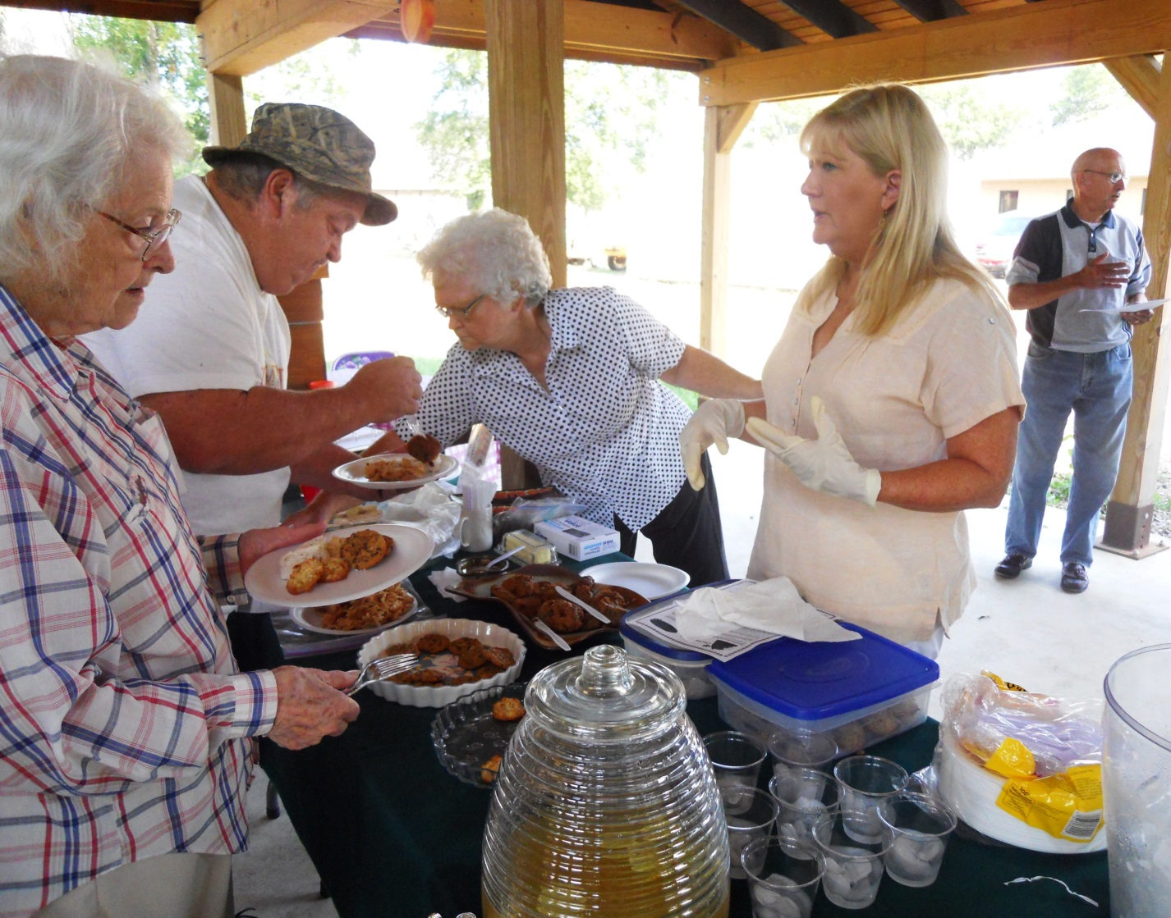
Cooking Demos
Civic Groups/Organizations

Slide 16

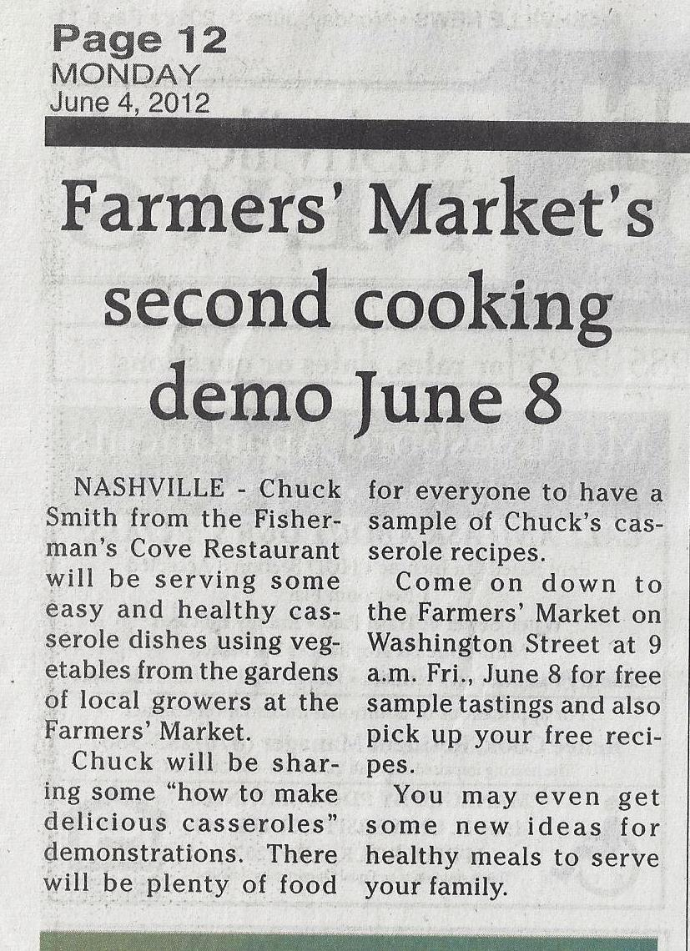

Cooking Demos Local Restaurants

Slide 17

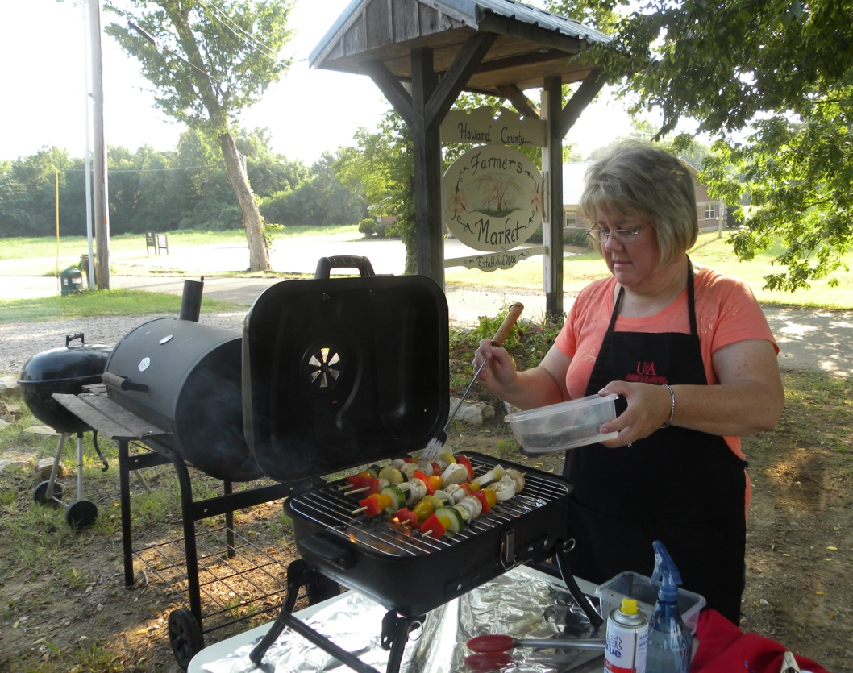
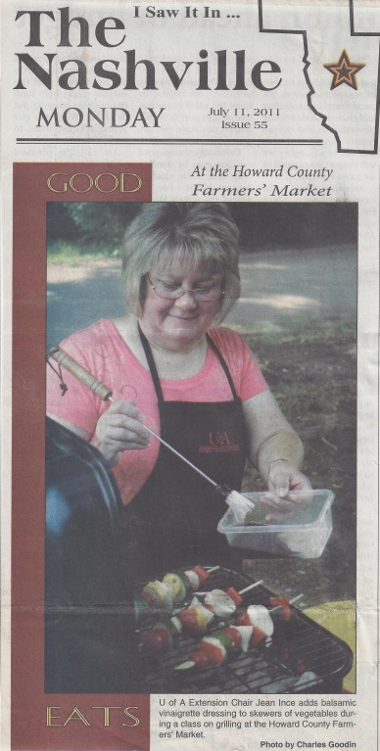
Cooking Demos
U of A Extension

Slide 18
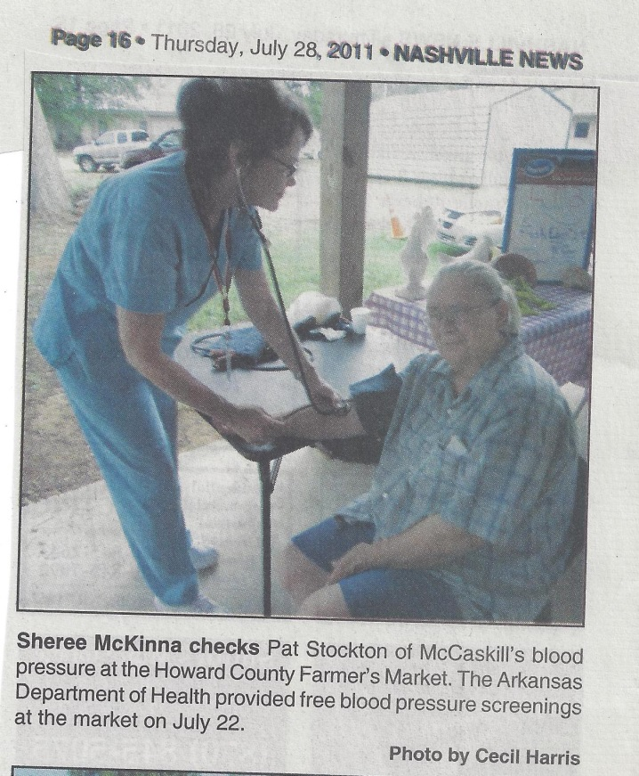
Other Events
Arkansas Department
of Health

Slide 19

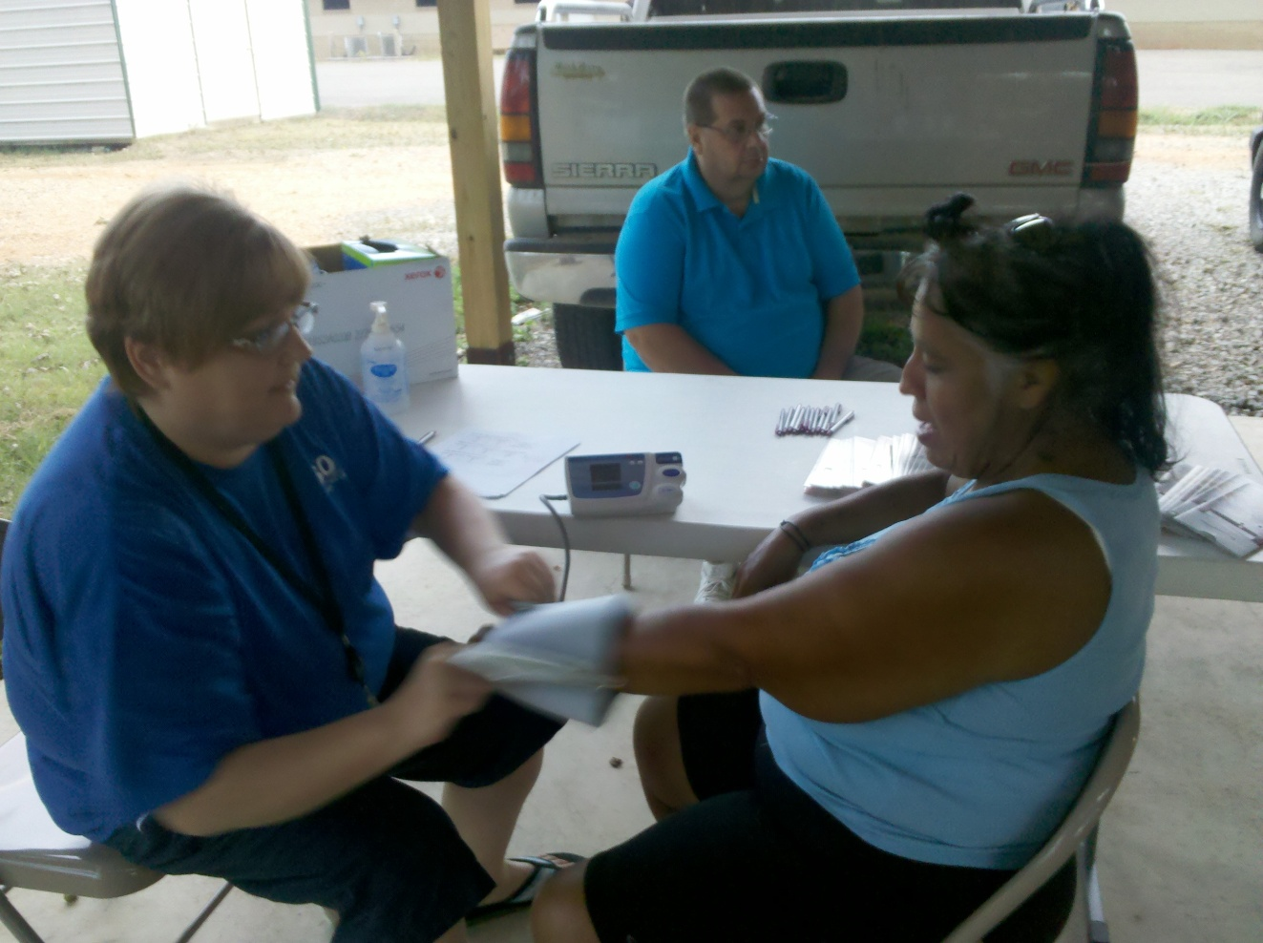
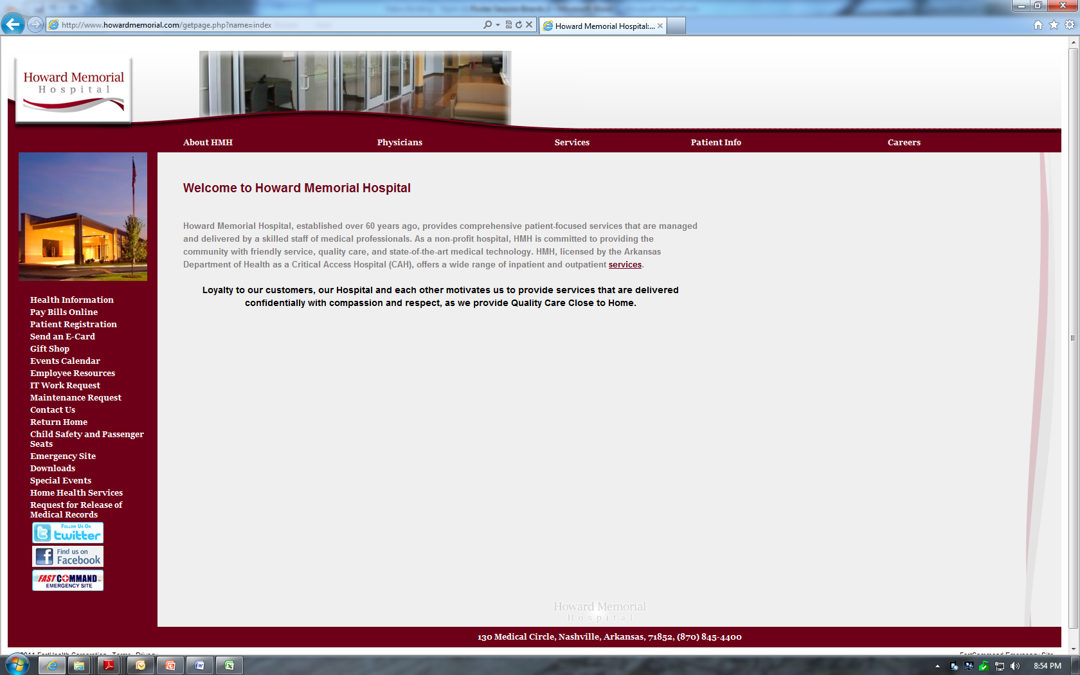
Local Hospital

Slide 20
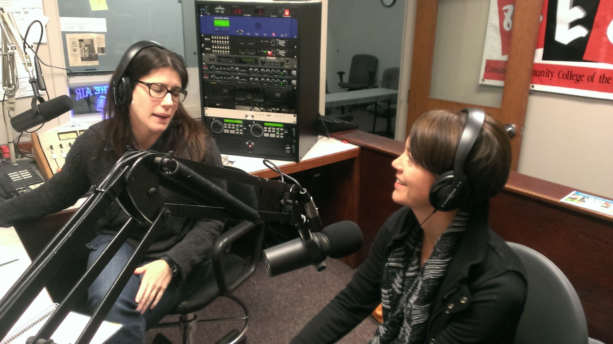
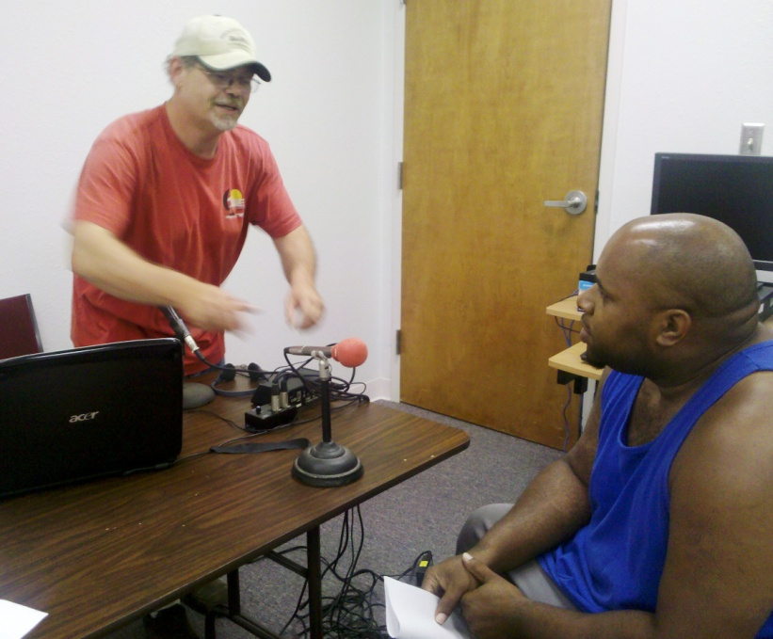
Local Radio Stations
PSA’s & Interviews
Notes:
PSA’s are free! Use them routinely!!!!!
Radio interviews help the stations have something to talk about . . . Do as many as you can to promote your market and what’s happening – hospitality, special events, cooking demos, etc.

Slide 21
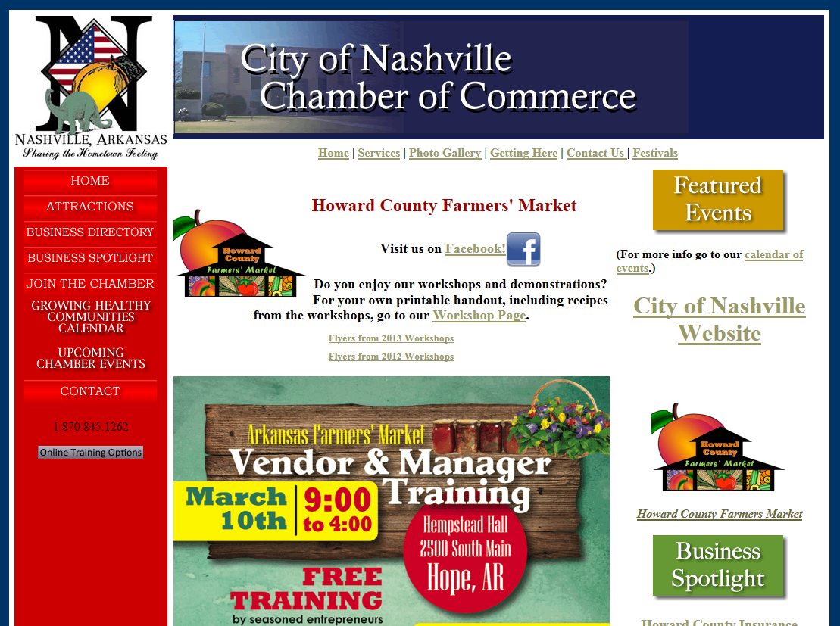

Slide 22
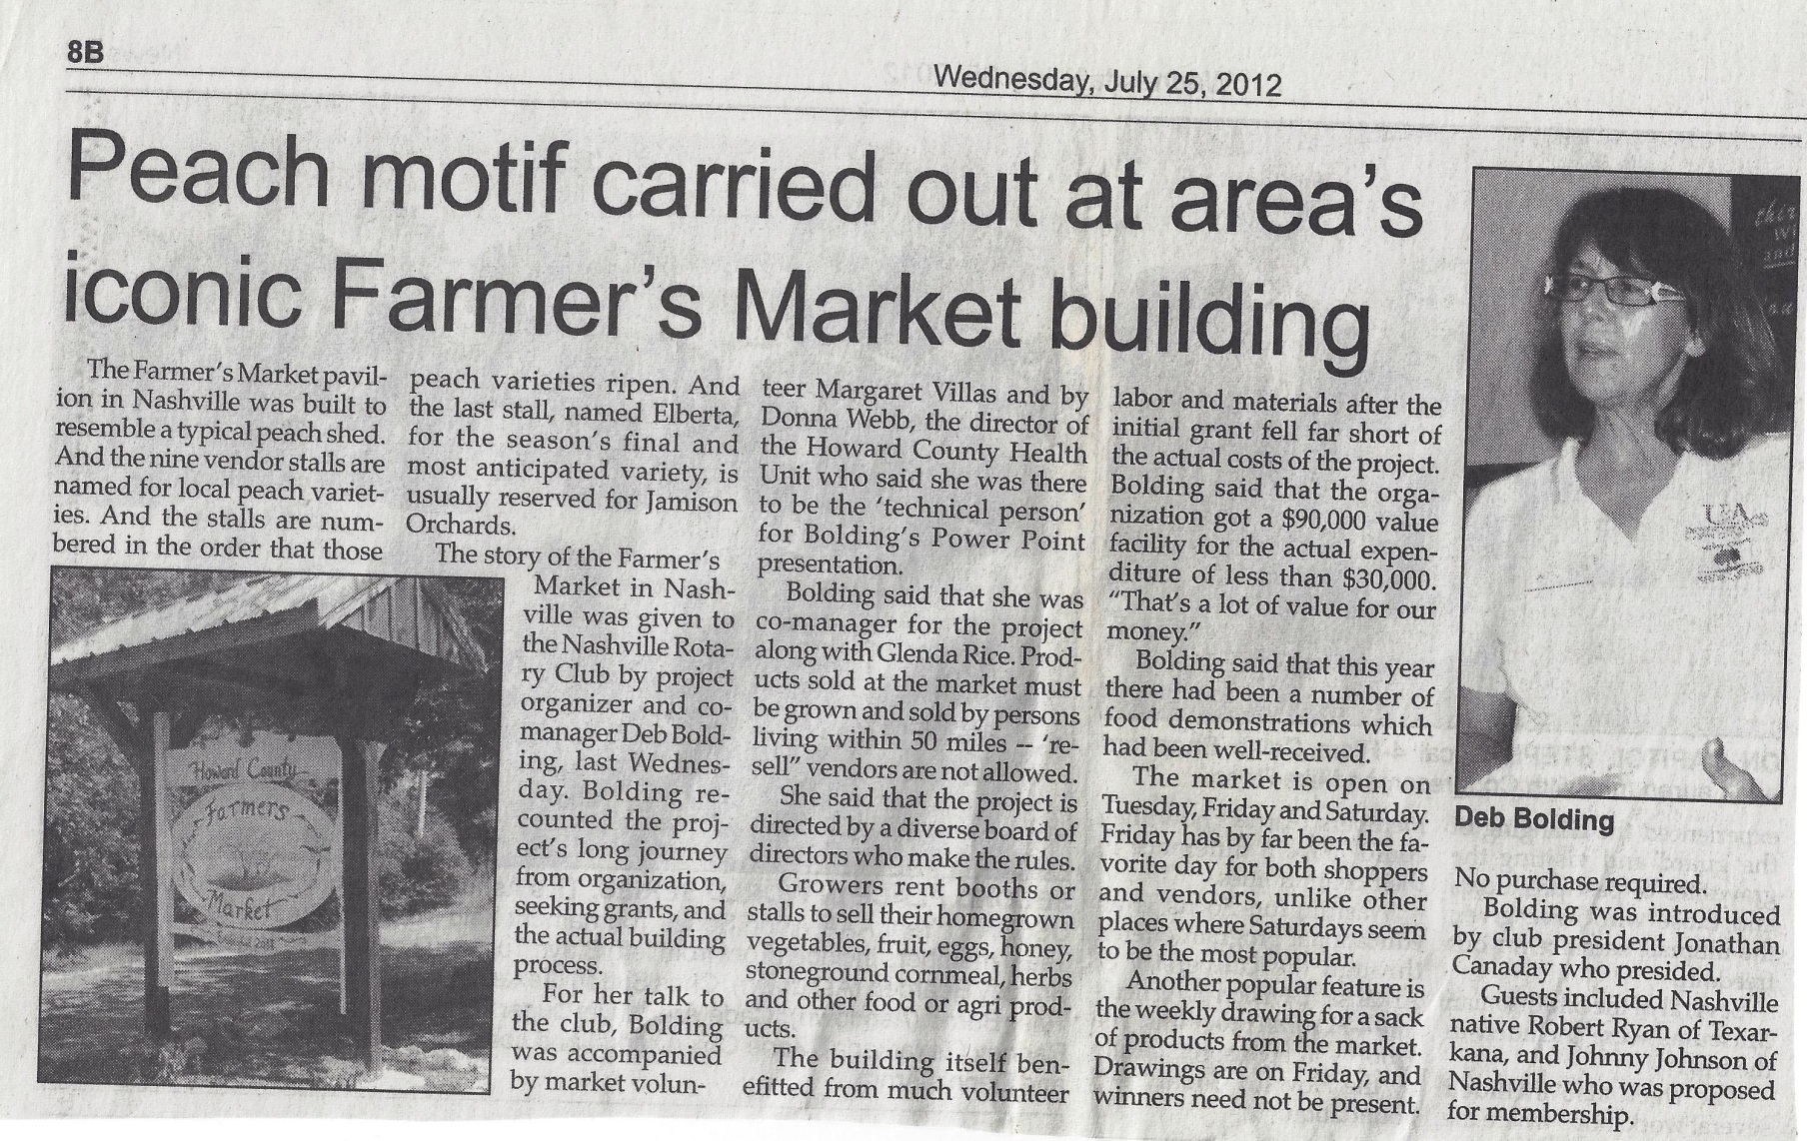
Recognize History / Heritage

Slide 23
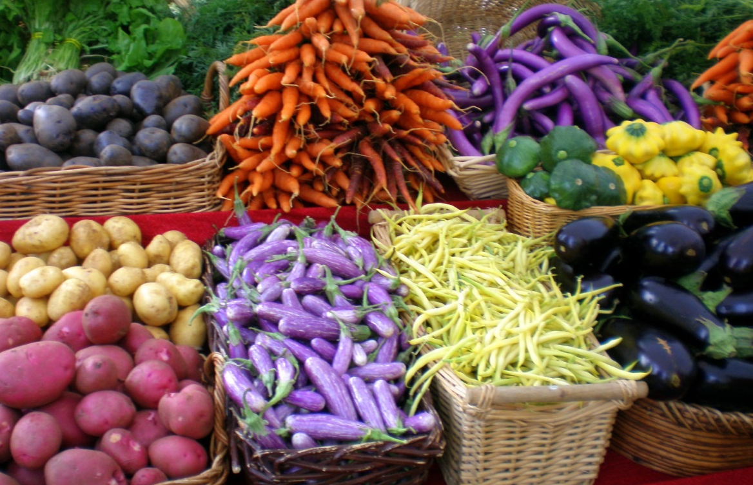
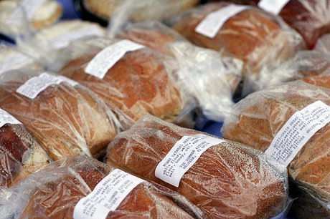
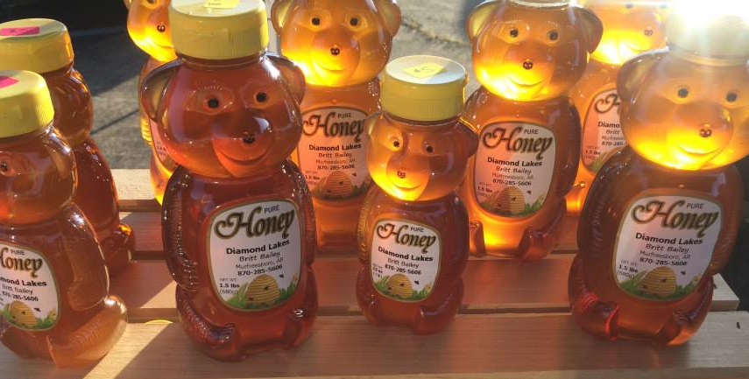
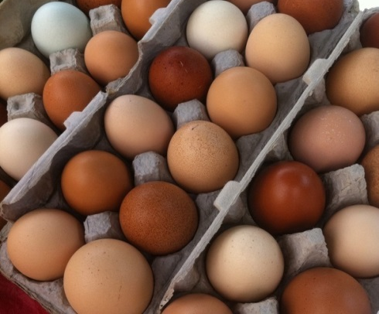
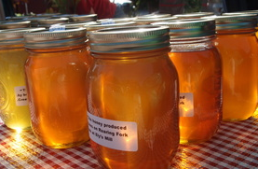
Diverse Mix of Vendors and Products
Requirement #3

Slide 24
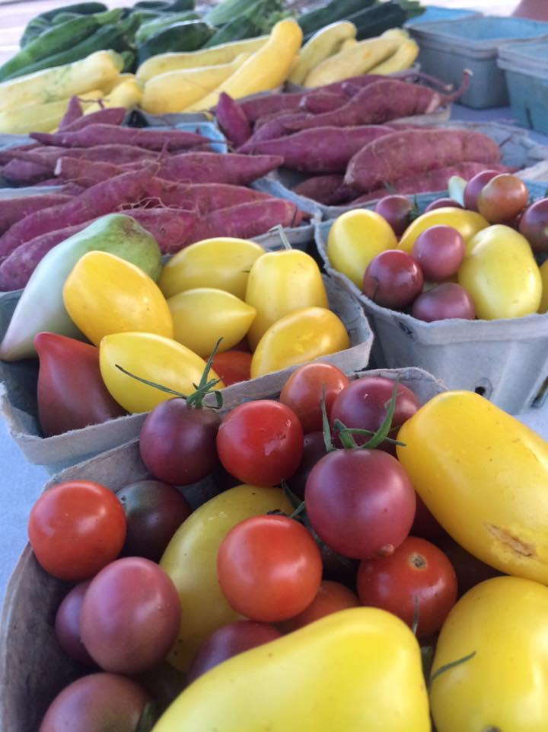
Raw Fresh Fruits and Vegetables
Whole
Uncut
Notes:
UNCUT IS IMPORTANT FOR NEWBIES

Slide 25

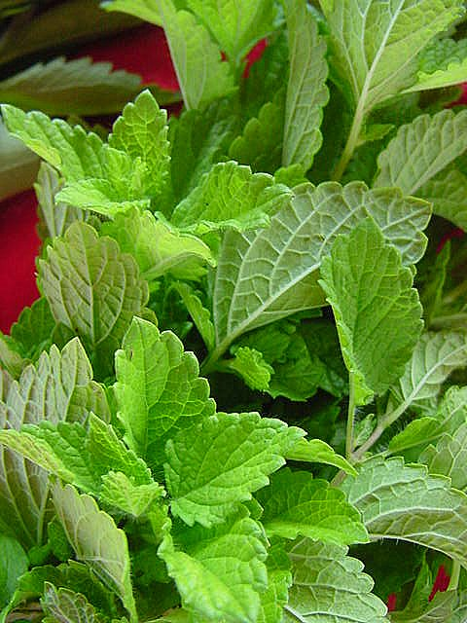
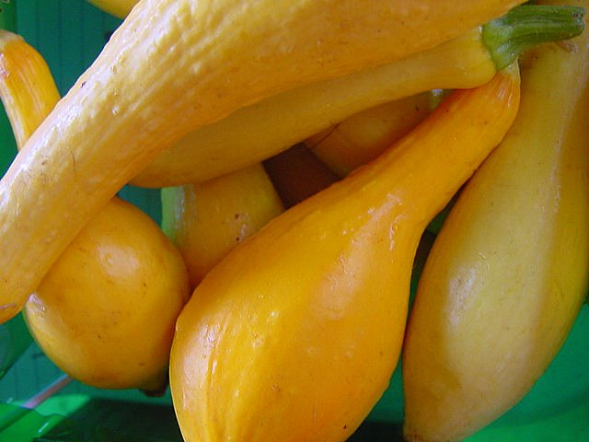
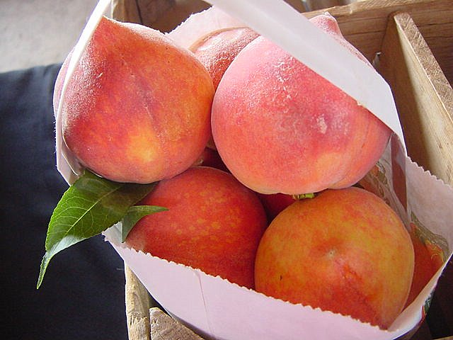
Quality and Freshness

Slide 26
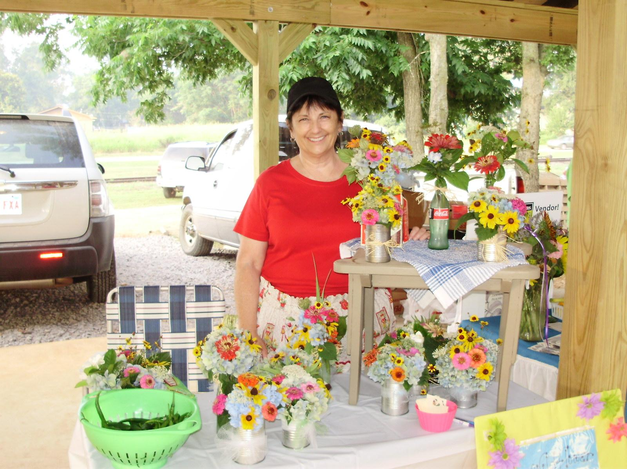
Fresh Cut Flowers

Slide 27
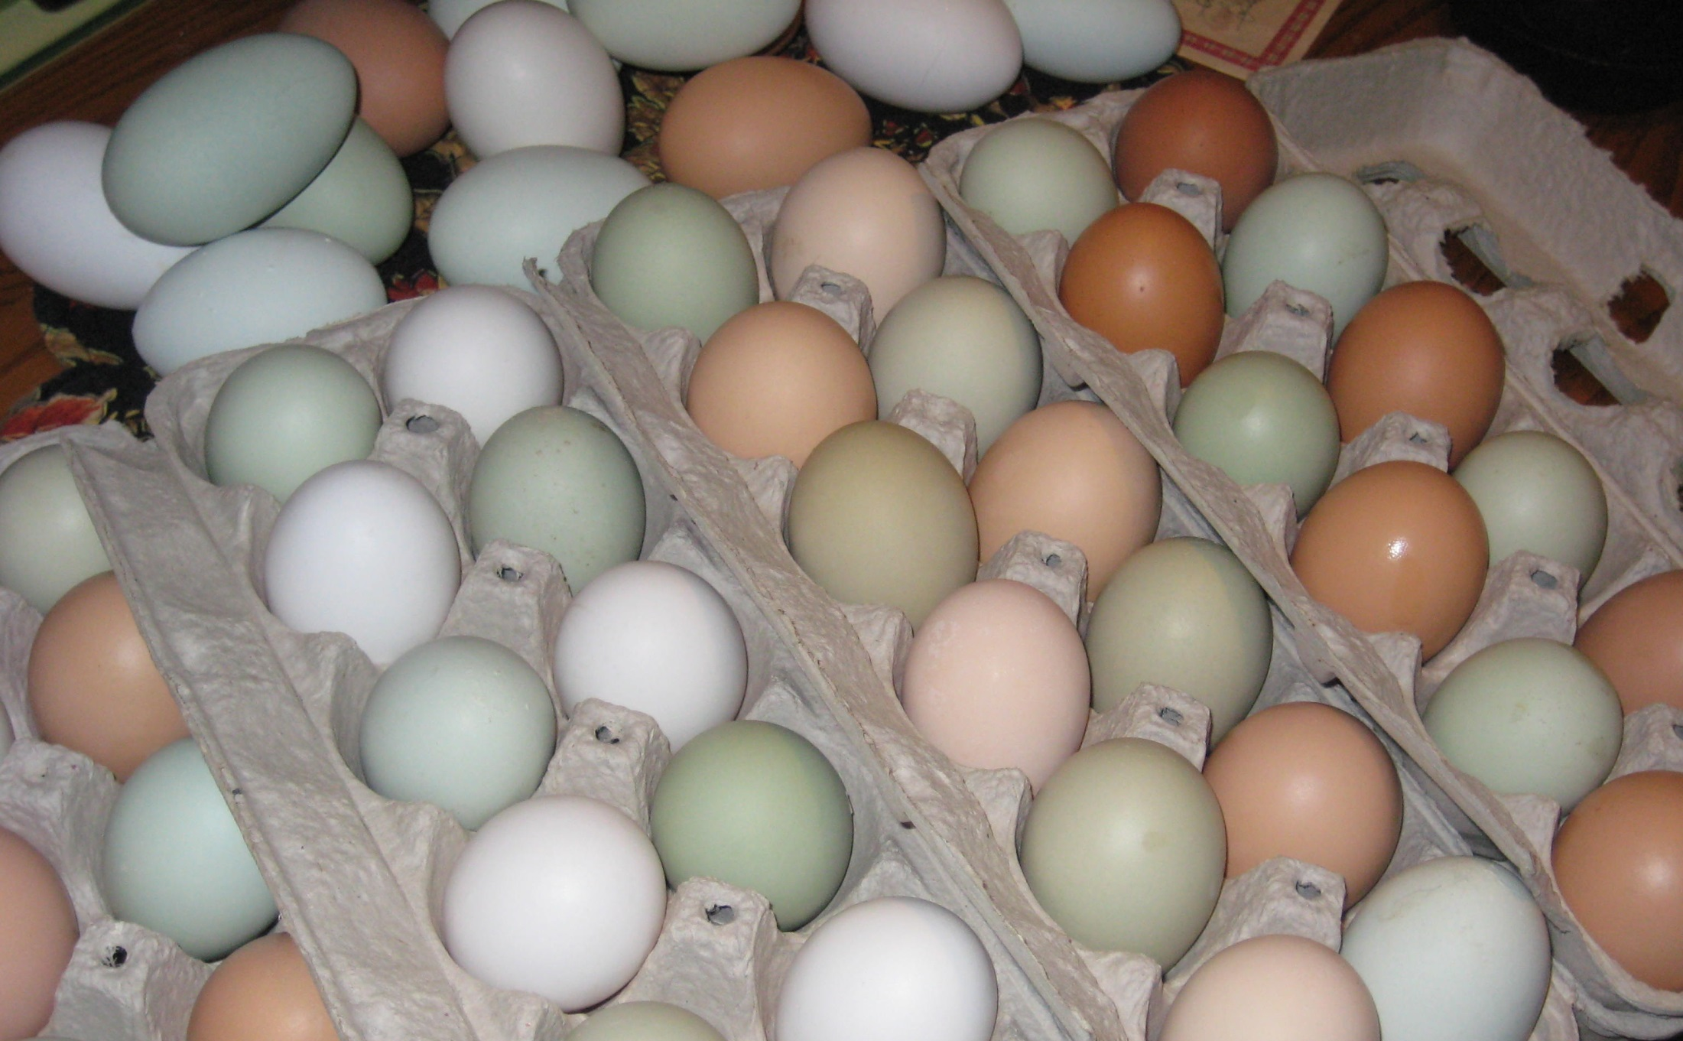
Fresh Eggs

Slide 28

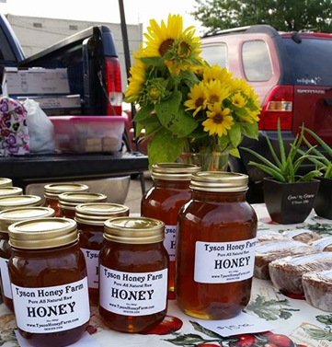
Honey

Slide 29
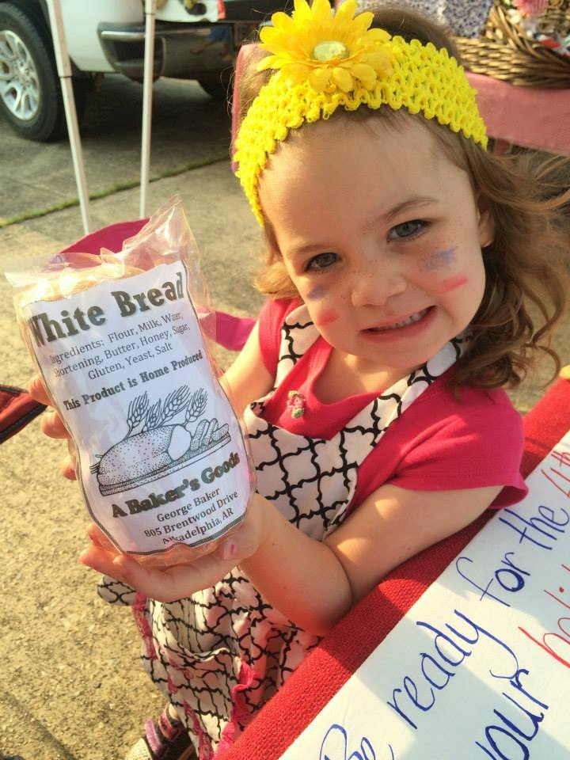
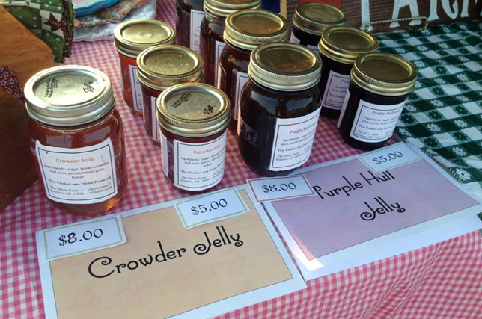
Cottage Foods

Slide 30



Grower Only? Or include Resale?

Slide 31
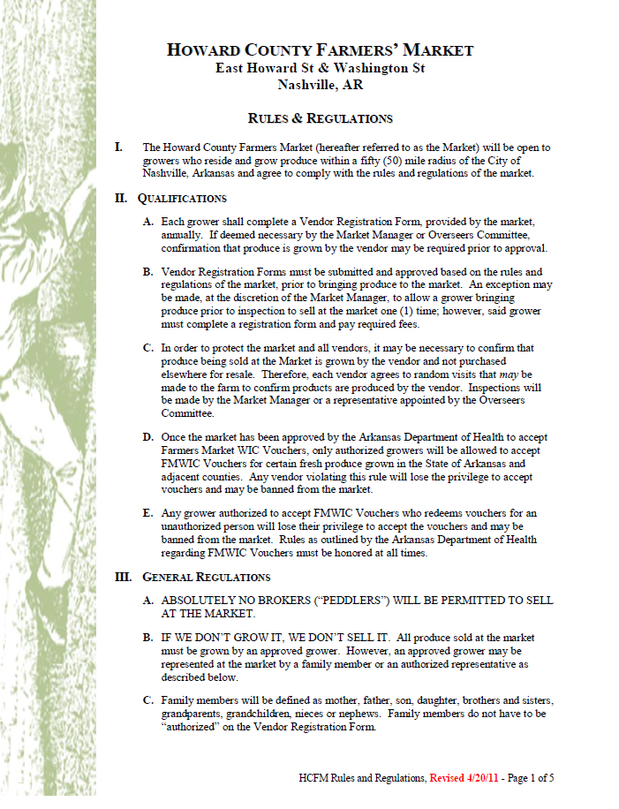
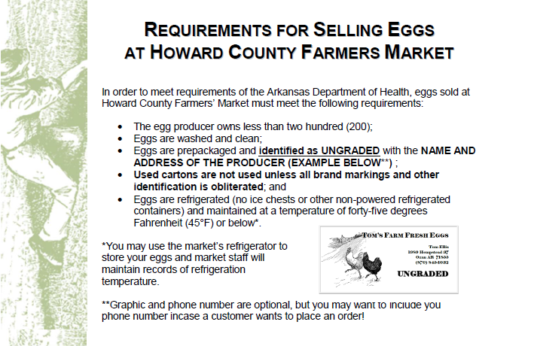
Fair and Enforceable Rules and Regulations
Requirement #4

Slide 32
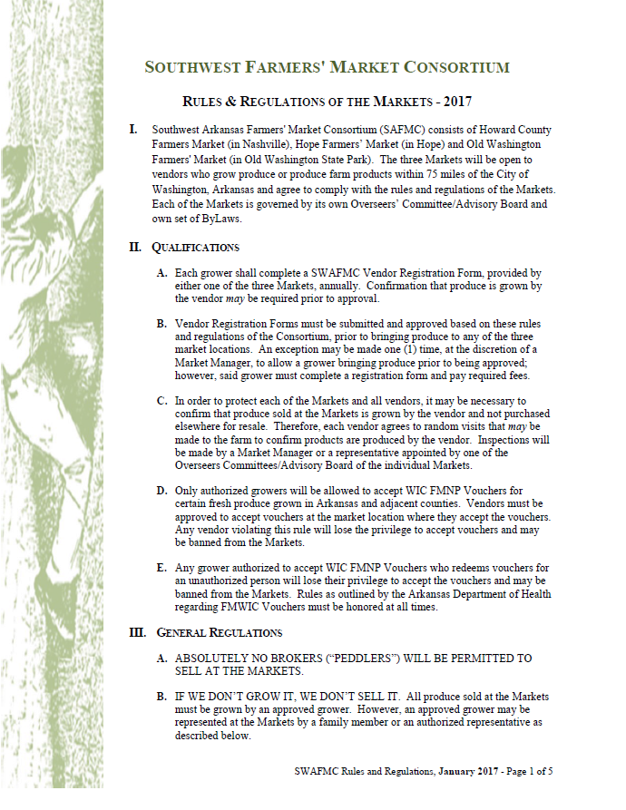

Rules written and agreed to . . .

Slide 33
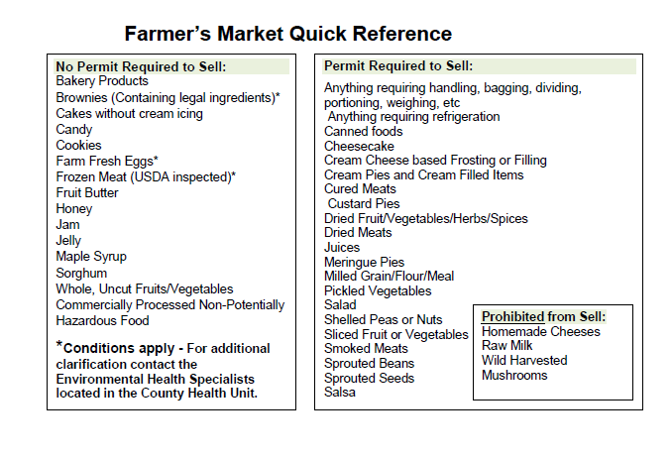
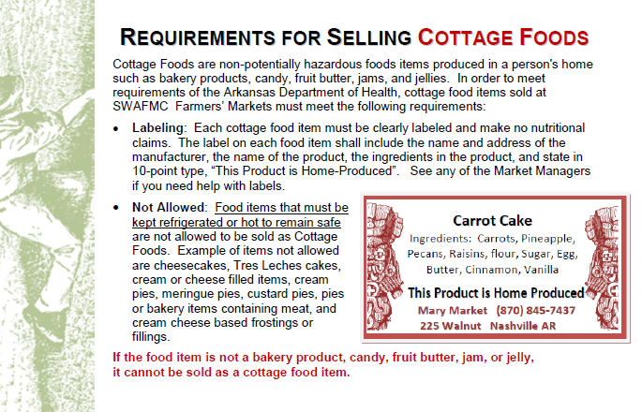
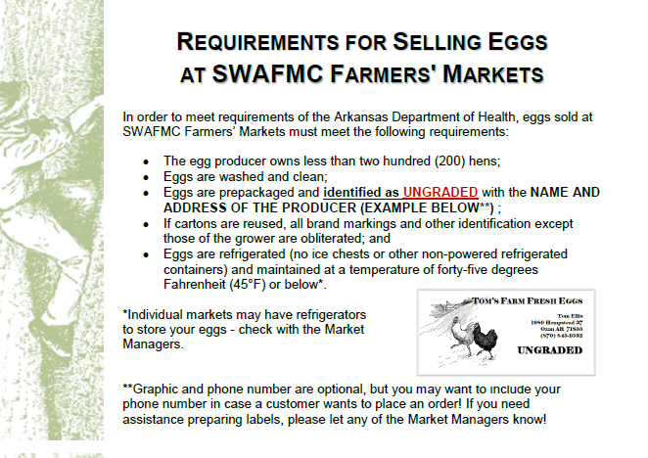

Guidelines for what can be sold and legal requirements

Slide 34



Slide 35

Not just the legal requirements!

Slide 36



Comprehensive Market Records
Requirement #5

Slide 37

Registration Forms

Slide 38

Day Manager’s Report

Slide 39

Farm Visit Report

Slide 40

Keep it Together . . . Available for future Reference!

Slide 41




Creative, Appropriate and Targeted Promotions
Requirement #6

Slide 42


Slide 43


Drawings for Produce and other Vendor Products

Slide 44


E-mail Notices

Slide 45



Flyers

Slide 46

“If you fail to plan, you are planning to fail.”
Benjamin Franklin

Slide 47
Dedicated, Passionate Market Manager
Requirement #7
Must manage day to day operations of the market, both on-site and off
Effectively promotes the market to consumers
Enforces the market’s rules fairly and with minimal conflicts
Mediates disputes that may between vendors and with customers
Represents the market to the public, regulatory agencies, etc.
Works with the board of directors, market committee, or other overseeing body
Maintains the market’s financial records
Understand the needs of farmers and is able to balance those needs with the customers and community at large
Fair, open-minded

Slide 48



Market Management is a big job!

Slide 49

Sound, Transparent, Sustainable Financial Plan
Requirement #8

Slide 50

Identify all expenses
Revisit and adjust frequently as necessary

Slide 51

Vendor Input
Requirement #9
Grower(s) serve on Board
Grower meetings

Slide 52


Continuous self-evaluation
Requirement #10
Notes:
Must keep good records for self-evaluation

Slide 53

Farmers’ Market Vendor Guide
In the Farmers’ Market Tool-Kit
(References & Manager Items)

Slide 54


In the Farmers’ Market Tool-Kit
(References)

Slide 55


Vendor Training PowerPoint and Handouts
☞ In the Farmers’ Market Tool-Kit

Slide 56

WIC FMNP Training PowerPoint and Handouts
☞ In the Farmers’ Market Tool-Kit

Slide 57
Sample Registration Packet Forms
In the Farmers’ Market Tool-Kit

Slide 58

Sample Market Management Items
In the Farmers’ Market Tool-Kit

Slide 59


UAEX Home-Garden Series Publications
In the Farmers’ Market Tool-Kit
(References)

Slide 60

Good Luck!

